Slide 1
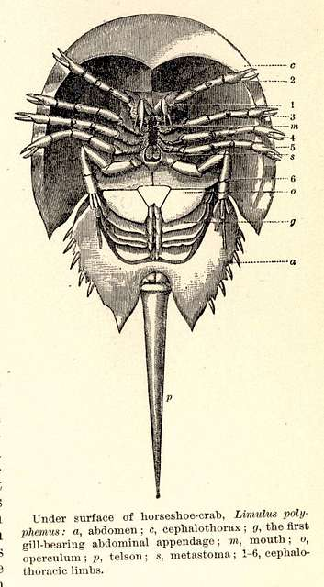
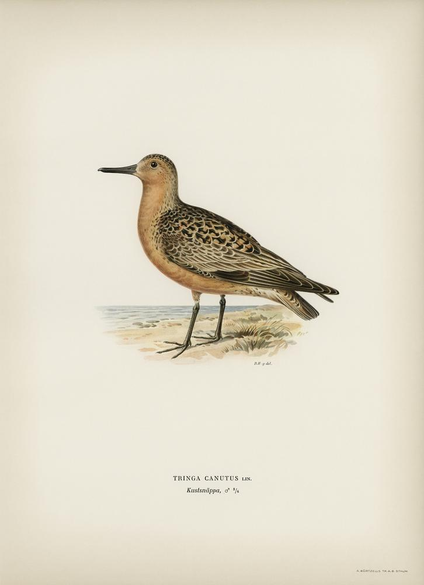
Case study: Red Knots and Horseshoe Crabs
NRES 421: Conservation Biology
Kevin Shoemaker – NRES

Slide 2
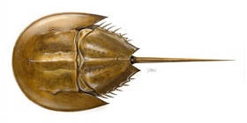
Atlantic States Marine Fisheries Commission (ASMFC). 2021. Revision to the Framework for Adaptive Management of Horseshoe Crab Harvest in the Delaware Bay Inclusive of Red Knot Conservation. Arlington, VA. 302 pp. http://www.asmfc.org/species/horseshoe-crab

Slide 3
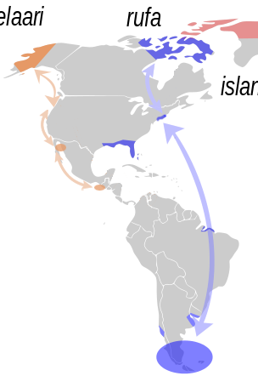
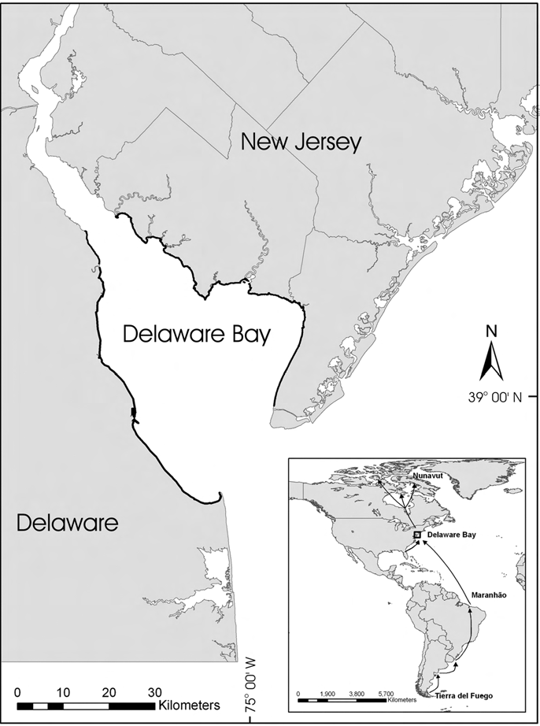

Slide 4
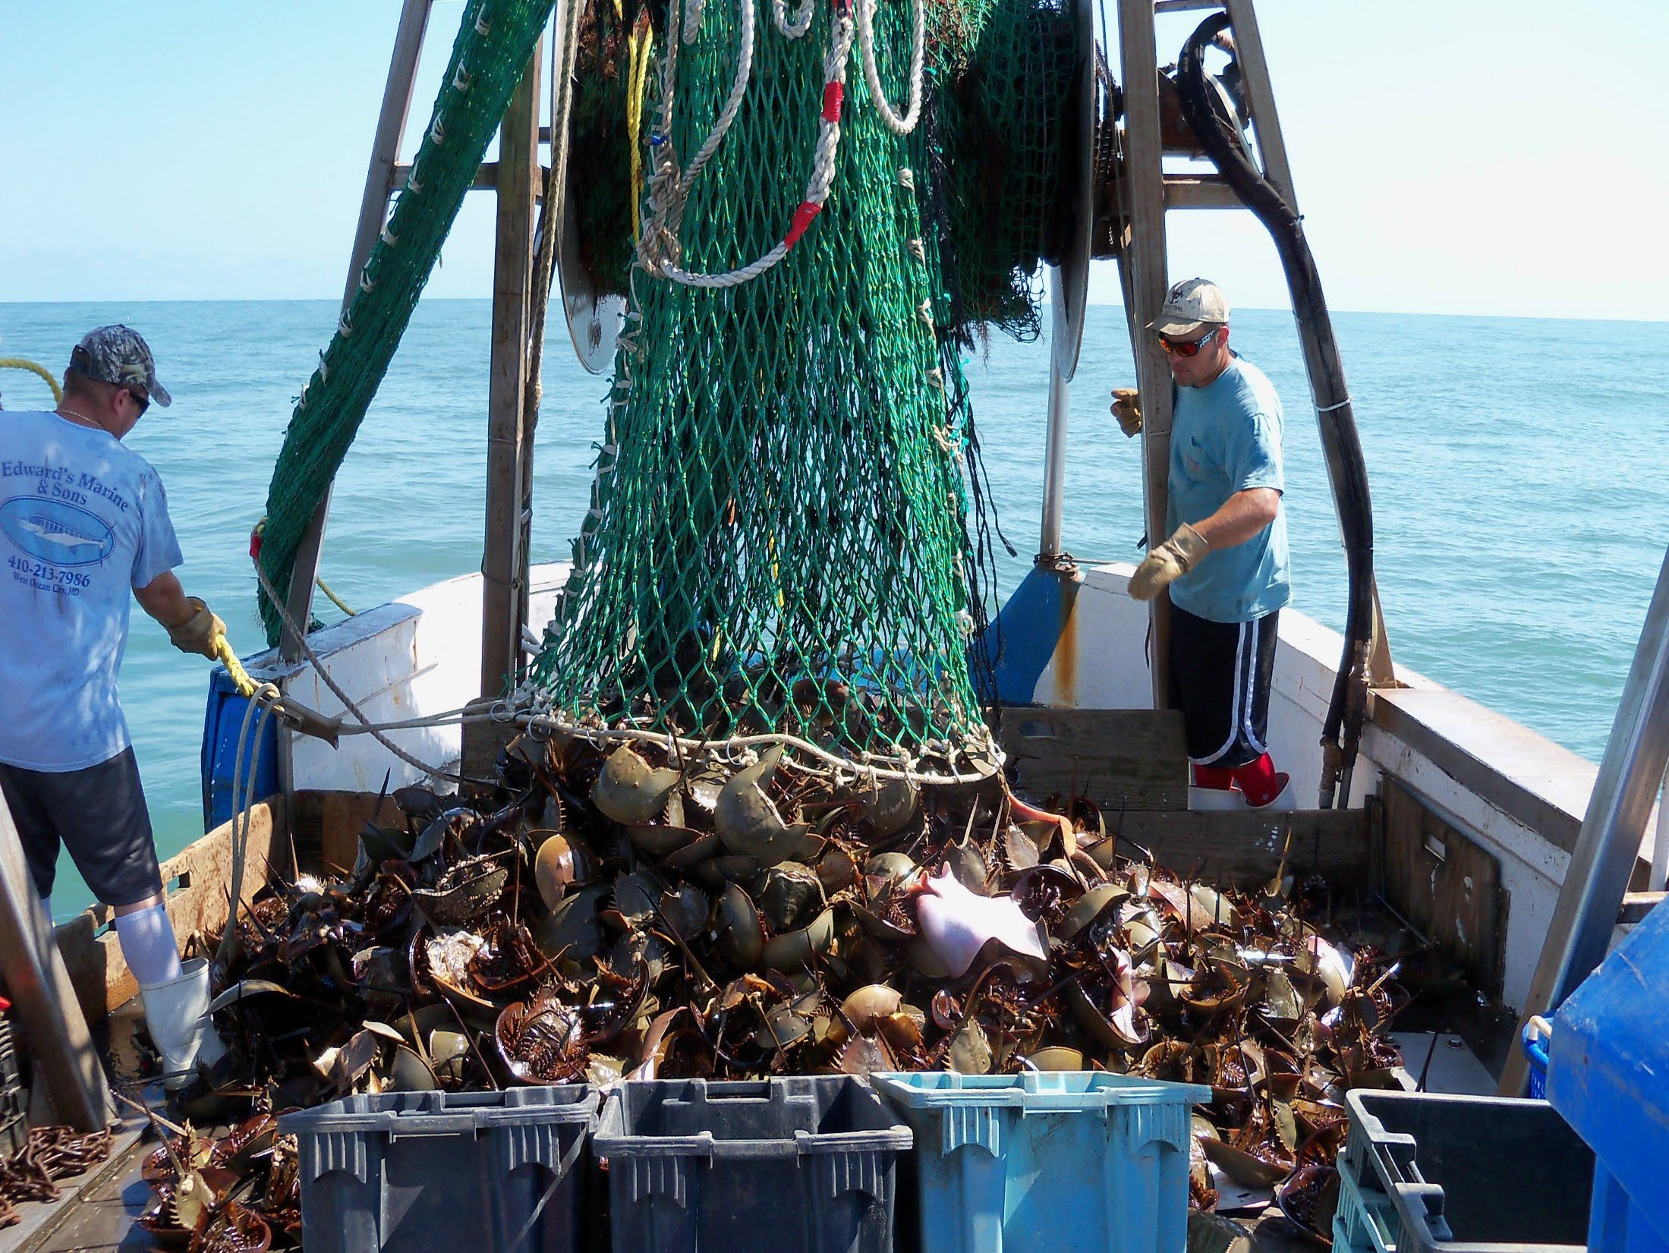

Slide 5
Overview of Changes
Problem Statement
Manage harvest of horseshoe crabs in the Delaware Bay to maximize harvest but also to maintain ecosystem integrity, provide adequate stopover habitat for migrating shorebirds, and ensure that the abundance of horseshoe crabs is not limiting the red knot stopover population or slowing recovery.

Slide 6
Management History for Horseshoe Crab stock
1990s – Unregulated harvest of Horseshoe Crabs
1998 – Fisheries Management Plan approved
2007 – Develop a multi-species management approach
2012 – Adaptive Resource Management (ARM) framework instituted
2019 – Beginning of ARM Revision
2022 – Revised ARM completed and peer-reviewed
2023 – Revised ARM instituted

Slide 7
A job for population models
Two simulation models
Horseshoe Crab population dynamics under various harvest scenarios
Red Knot population dynamics
Key parameters modeled as a function of female horseshoe crab abundance
Adult survival is higher in years with more female horseshoe crabs!
Models fitted using all available data sources
Run both models for many years into the future and try to develop a harvest strategy that optimizes management goals!

Slide 8
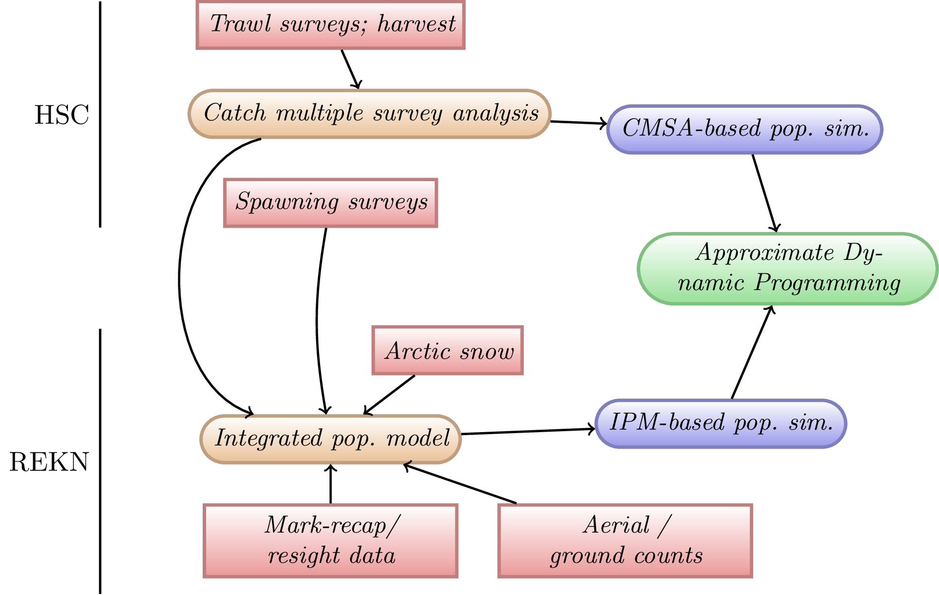
Revised ARM Conceptual Model

Slide 9
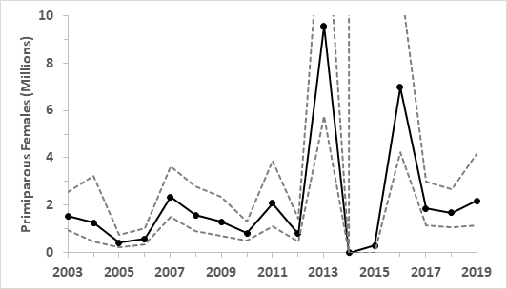
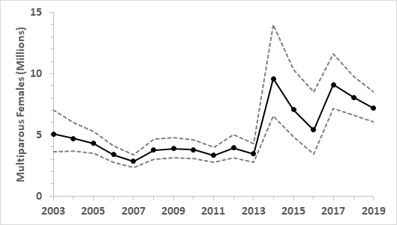
CMSA Results – Female Horseshoe Crabs
Primiparous (R)
Multiparous (N)

Slide 10
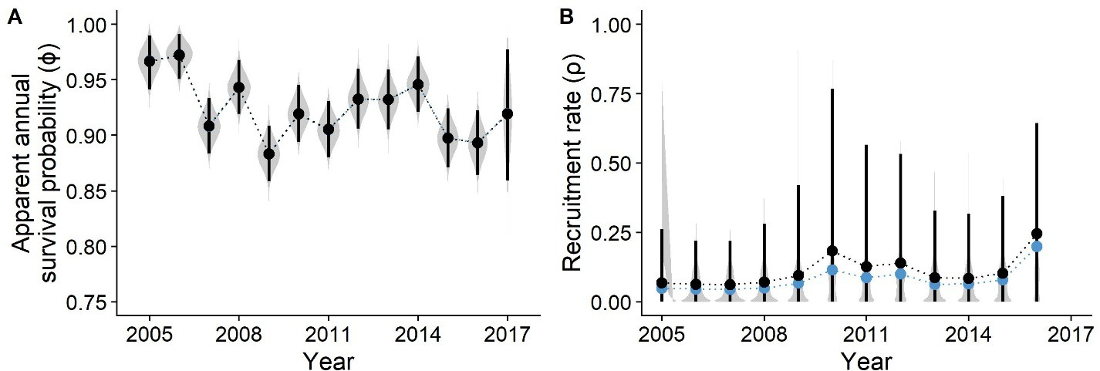
Red Knot IPM – Survival and Recruitment
Red Knot Population Model: IPM Results

Slide 11
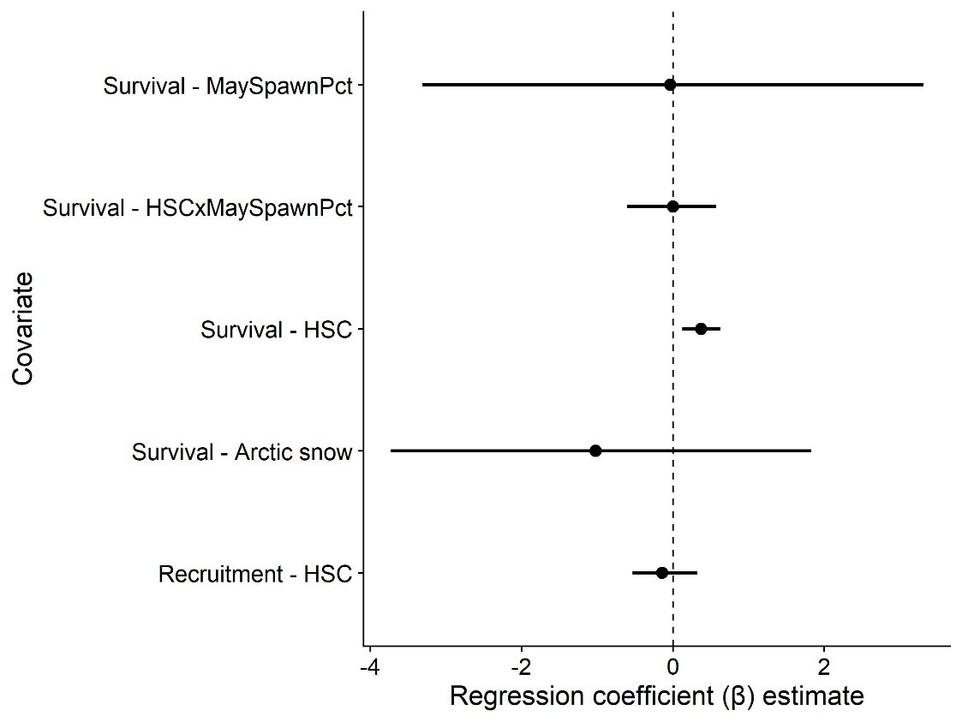
Red Knot IPM – Covariate Effects

Slide 12
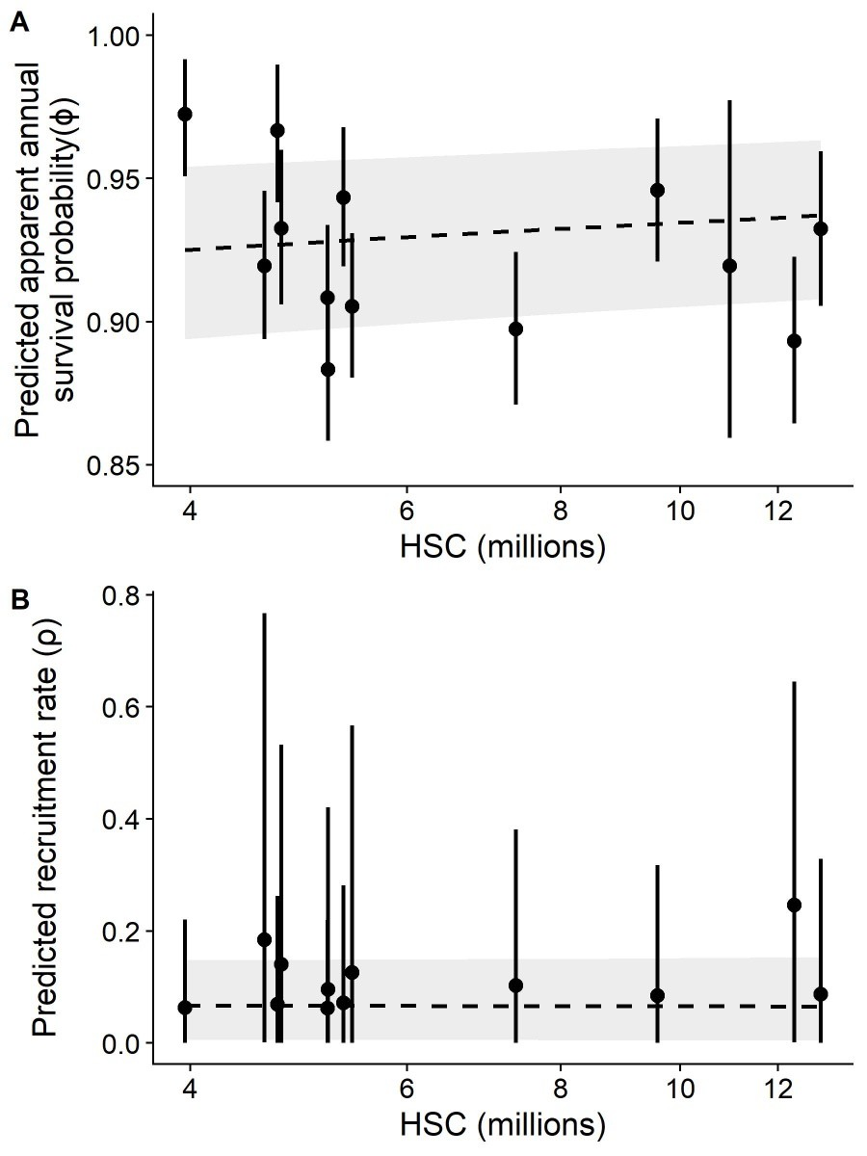
Red Knot IPM – Covariate Effects

Slide 13
Population Projection Models (simulations)
Horseshoe Crabs
Based loosely on CMSA results
Annual recruitment process derived from CMSA results
Fit a distribution to the CMSA results (bivariate lognormal)
Decreased recruitment when total females <3.75 million or sex ratio becomes female biased
Red Knots
Simulation model based directly on the IPM
Models were then linked and simulated together for the optimization of harvest policy functions in Approximate Dynamic Programing (ADP)

Slide 14
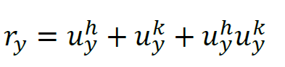
‘Reward' Function for optimization
Annual reward:
Multiple Criteria Decision Analysis: ideal situation is when we harvest the maximum allowed and red knot abundance ≥81,900
Values of u can range from 0 to 1; therefore r_{y} = (0 , 3)
r_{y} = 1 + 1 + 1x1 = 3 (Everybody is happy!)
This formulation of the reward function prevents getting all the reward from only horseshoe crab harvest (e.g., r_{y} = 1 + 0 + 1x0 = 1)

Slide 15
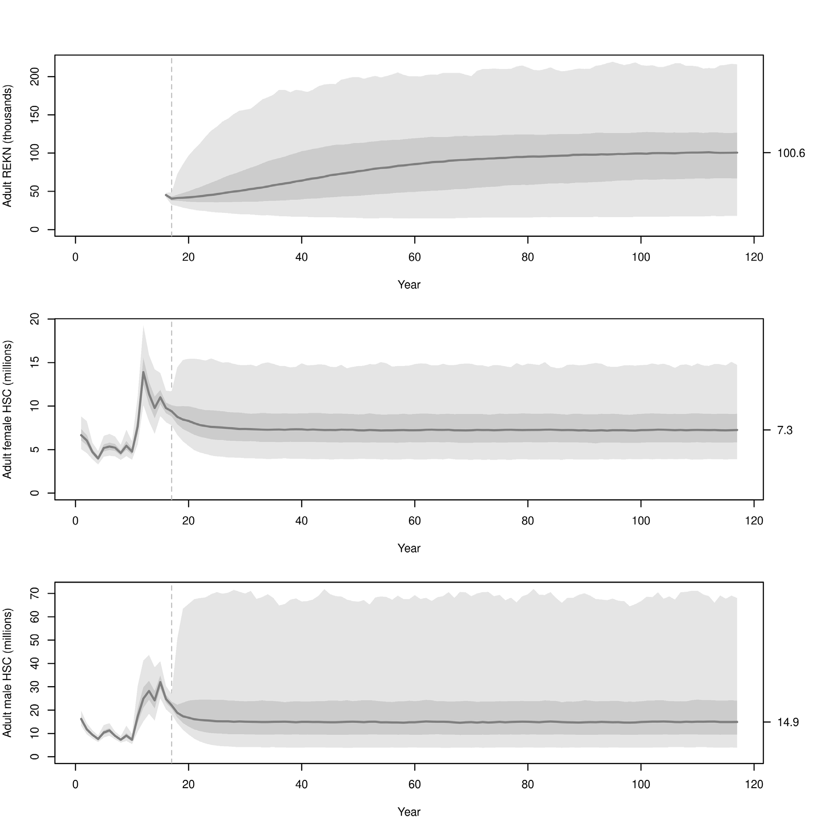
Results: Predicted population sizes
REKN simulation results:
HSC simulation results (female):
HSC simulation results (male):

Slide 16
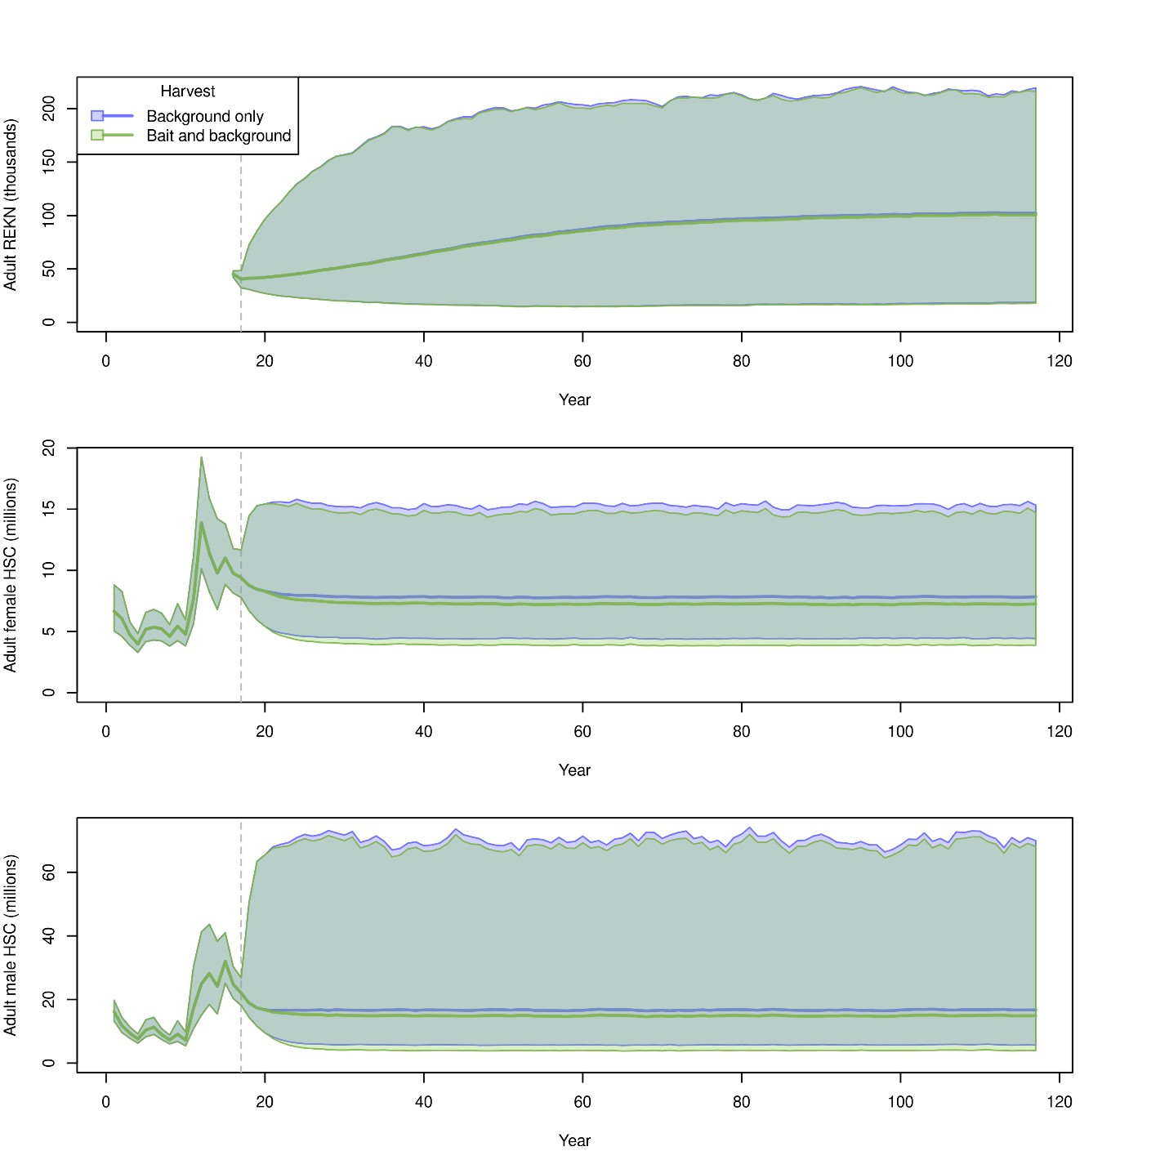
Results: Predicted population sizes
REKN simulation results:
HSC simulation results (female):
HSC simulation results (male):
Notes:
This is the figure that convinced USFWS that the harvest of female HSC is not going to harm HSC or REKN population

Slide 17
Example Harvest Recommendation
Year | VA Tech Swept Area Estimates |  | Red knots | Optimal HSC Harvest (previous ARM)
 | Female HSC | Male HSC |  | Female | Male
2017 | 6,654,877 | 21,405,997 | 49,405 | 0 | 500,000
2018 | 7,555,622 | 19,346,403 | 45,221 | 0 | 500,000
2019 | 7,934,057 | 16,645,912 | 45,133 | 0 | 500,000
Year | CMSA Estimates |  | Red knots | Optimal HSC Harvest (revised ARM)
 | Female HSC | Male HSC |  | Female | Male
2017 | 10,967,100 | 31,664,430 | 49,405 | 154,483 | 500,000
2018 | 9,735,690 | 24,715,290 | 45,221 | 146,792 | 500,000
2019 | 9,357,400 | 21,897,920 | 45,133 | 144,803 | 500,000

Slide 19
A closer look at the ASMFC Horseshoe Crab management framework

Slide 20
Red Knot model

Slide 21
Let’s return to those REKN/HSC relationships…

Slide 22
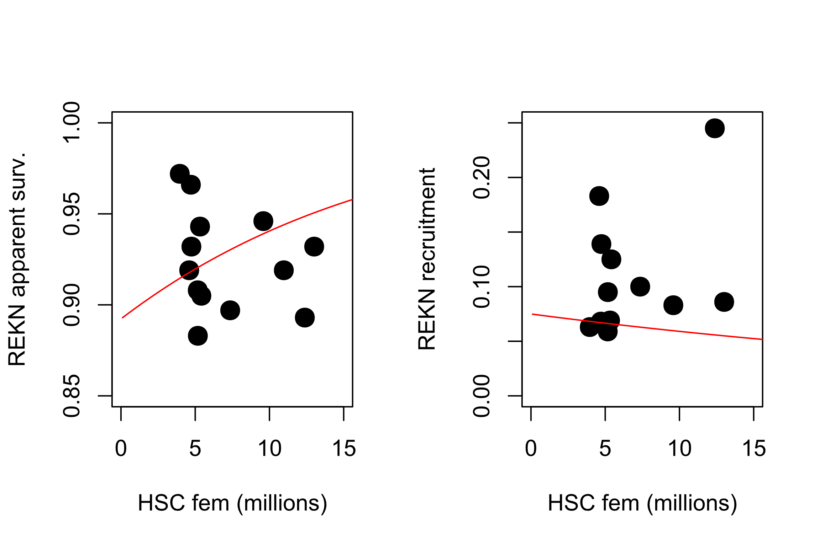

Slide 23
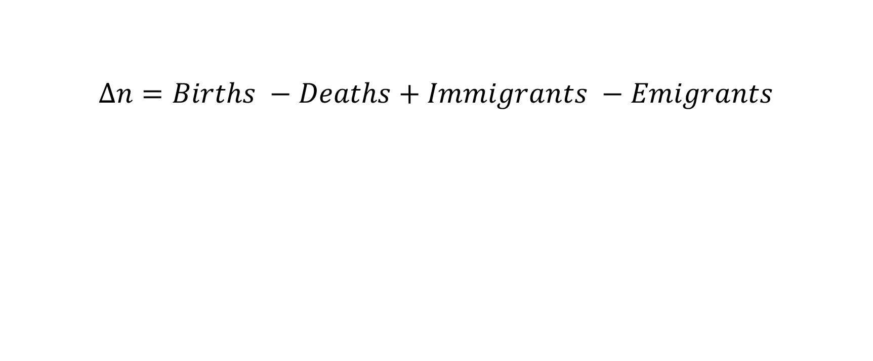
Fundamentals of population ecology: exponential growth
$$∆n=Births −Deaths+Immigrants −Emigrants$$
Per capita births minus per capita deaths = r, or the intrinsic rate of increase
Often ignored at first – assume a self-contained population

Slide 24

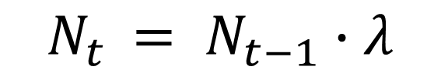
Fundamentals of population ecology: exponential growth
$$N_{t }= N_{t−1}∙λ$$
$$N_{t }= N_{0}∙λ^{t}$$
Growing or stable population: Lambda ≥ 1 (r ≥ 0)
Notes:
What is the per-capita population growth rate?
The power of population is indefinitely greater than the power in the earth to produce subsistence for man

Slide 25
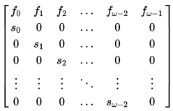
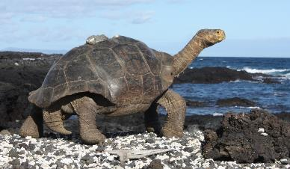
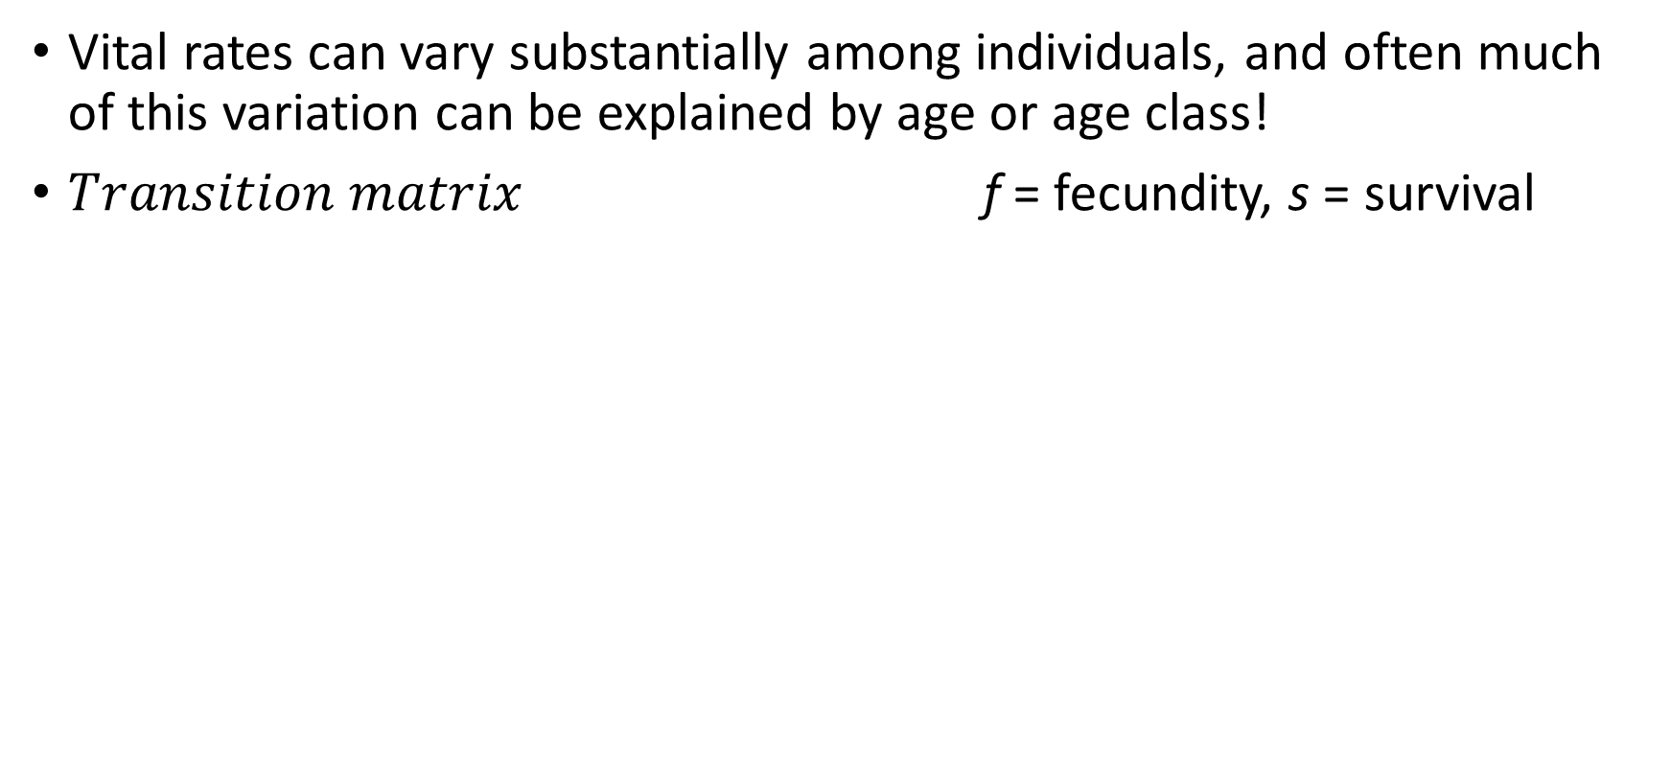
Age Structure and Stage Structure
Vital rates can vary substantially among individuals, and often much of this variation can be explained by age or age class!
$Transition matrix$ f = fecundity, s = survival
Important for species with highly “skewed” fecundity and survival rates.
For example, turtles and tortoises:
Low survival in first few years of life, very high survival in later years
Non-reproductive for many years, high reproductive capacity when adults

Slide 26
Build a Red Knot population model!

Slide 27
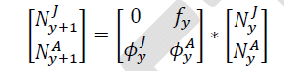
Two-stage population model for Red Knot:
ϕ^{A}
ϕ^{J}
Juveniles
Adults
f^{J}

Slide 28
Red Knot (REKN) population model specification
Life history: juvenile and adult stages. Start breeding at 2 years of age. Can live up to 20 years, but most don’t make it past 7 or 8 years.
Adult Survival rate: 93% per year at “normal” HSC abundance
Juvenile Survival rate: 75% annually
Reproduction: each adult produces 0.15 offspring annually that survive to become juveniles
Abundance: around 50,000 adults and 5,000 juveniles
Let’s build a REKN population model using InsightMaker

Slide 29
REKN scenario tests (group activity)
Baseline- run the model with all parameters at baseline levels (normal levels of horseshoe crab eggs)
Run the model with the HSC population cut in half
Run the model with the HSC population set to zero (catastrophic collapse of the population)
Please work together to describe the results of your scenario tests, and what this might mean for regulating the harvest of horseshoe crabs in Delaware Bay. Does this result make sense, based on what you know about red knots?

Slide 30
(In class exercise)
https://insightmaker.com/insight/hoWpE5JlD9x5AaPHujVg4/Red-Knot-Matrix-Model

Slide 31
REKN Lambda = 1.04 (at baseline HSC abundance)
REKN Lambda = 1.01 (at ZERO HSC abundance)

Slide 32
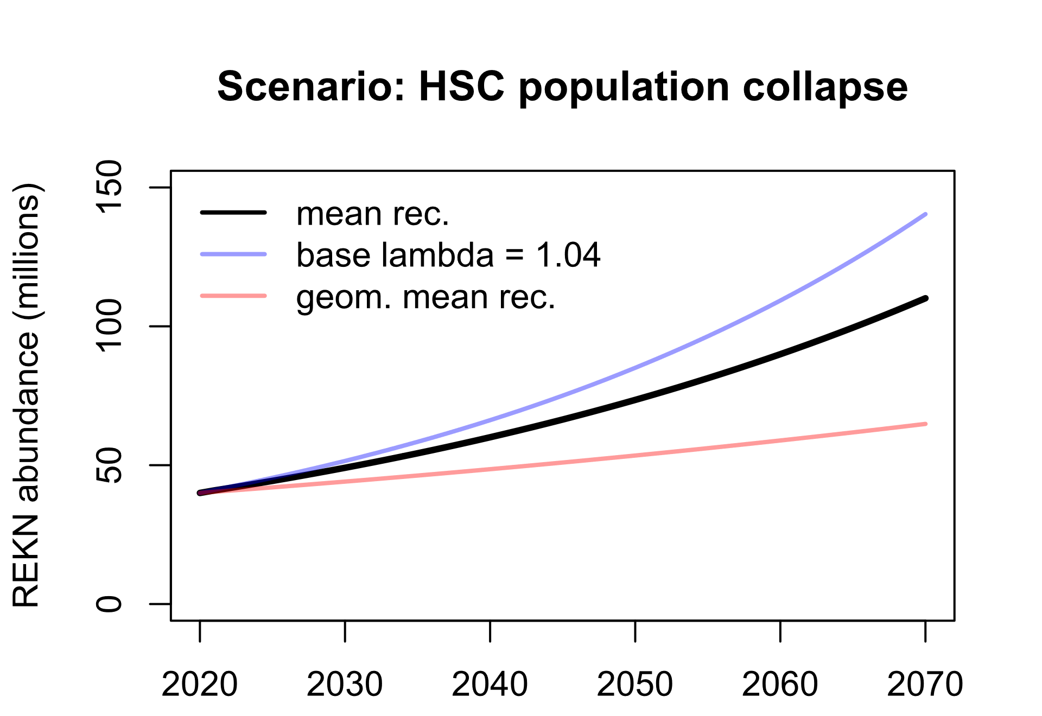

Slide 33

Horseshoe crab model

Slide 34
Fundamentals of population ecology: stochasticity and uncertainty
Lack of Knowledge
Simulate under many replicates of alternative scenarios covering the range of uncertainty
Randomness of the system
Environmental Stochasticity
Demographic stochasticity

Slide 35
The future is uncertain. Model it anyway!
Any of these trajectories might represent the future of the population. The distribution of outcomes can be interpreted as our prediction.

Slide 36
Horseshoe crab model specification
Only model female adult (reproductive) HSC (single stock)
Starting population size is around 10 million females in Delaware Bay
Baseline harvest due to all other sources (biomedical, bycatch) is around 50,000 per year
Recruitment rate (rate of entry of new adults into the population each year) is modeled using a lognormal random number generator with average recruitment of 3.2 million per year and log-sd of 0.5.
Adult mortality is 30%

Slide 37
HSC scenario tests (group activity)
Baseline- run the model with no commercial harvest of females (only baseline harvest)
Run the model with maximum allowable commercial harvest of females: 210,000 females harvested per year
Run the model with 2 million females harvested each year
Return female harvest to 210,000 females per year. What is the minimum mean-log recruitment value that allows female abundance to remain above 6 million over the next 50 years?
Please work together to describe the results of your scenario tests. Do you think this population is likely to be resilient to the maximum allowable female harvest rates? Why or why not?

Slide 38
(In class exercise)
https://insightmaker.com/insight/gim35Z9XDbmFy7gcQy2JD/Horseshoe-crab-model

Slide 39
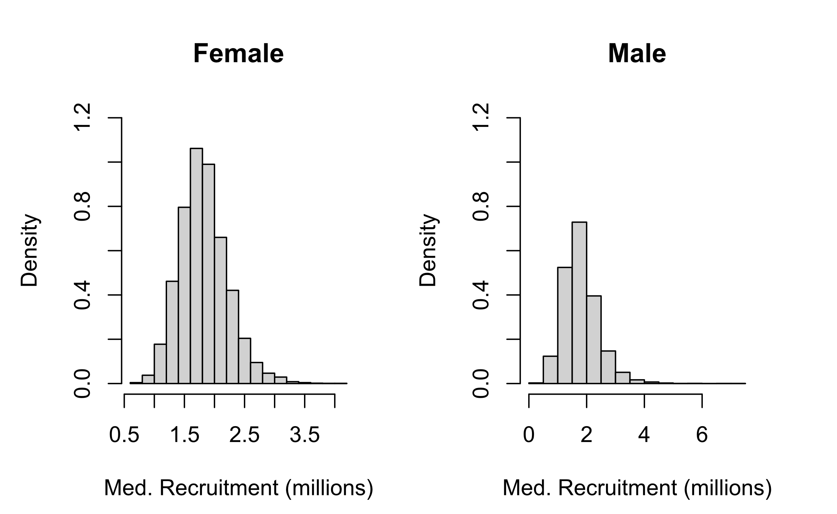

Slide 40
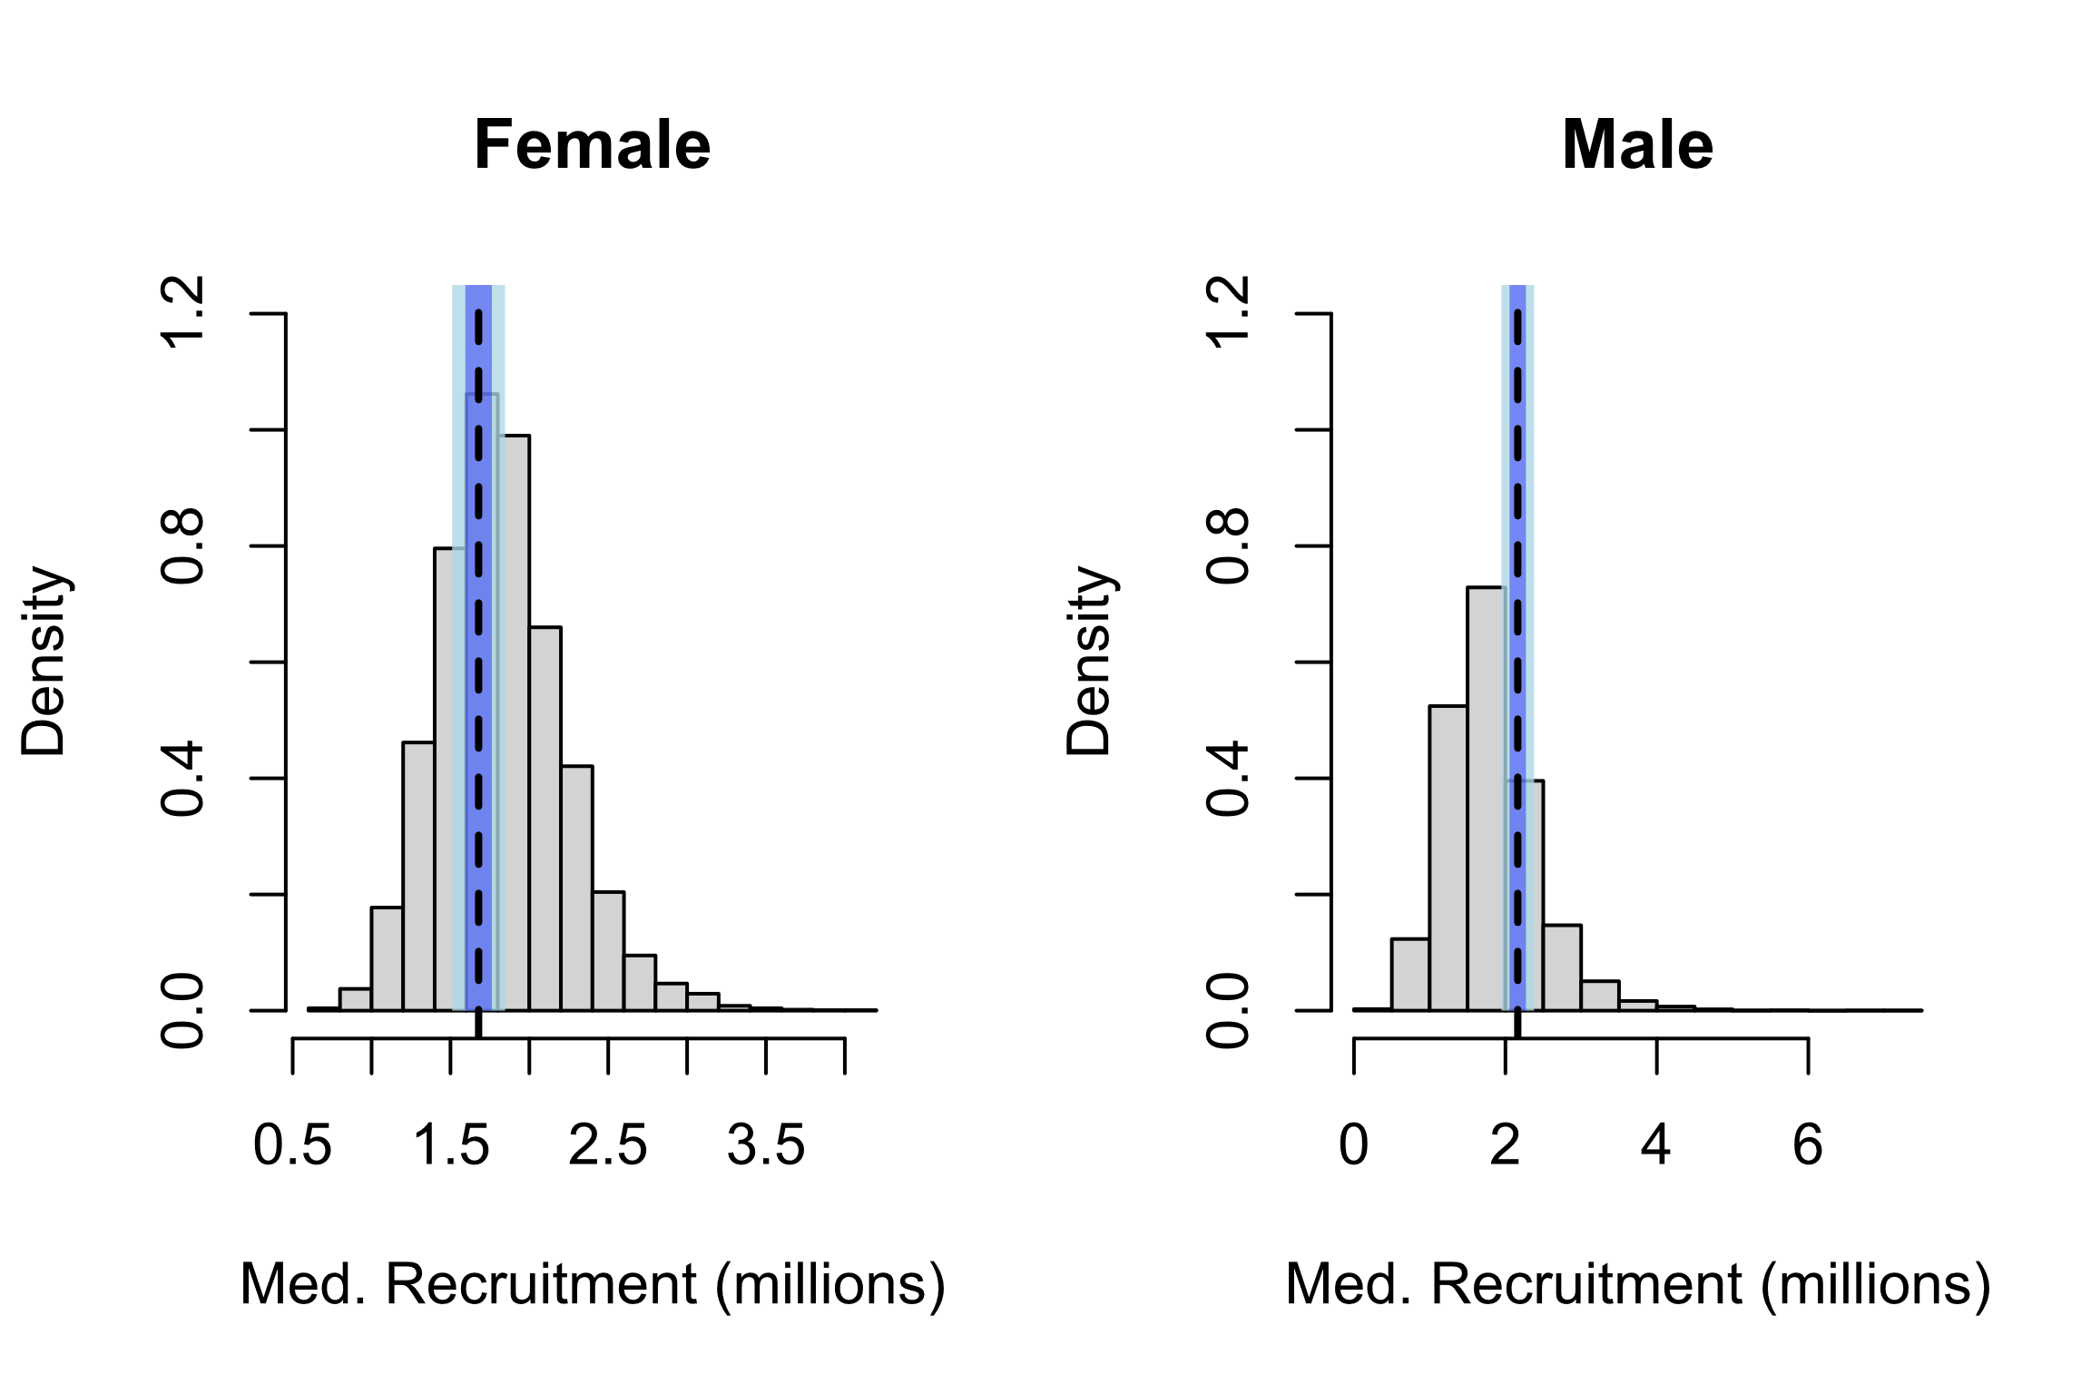

Slide 41
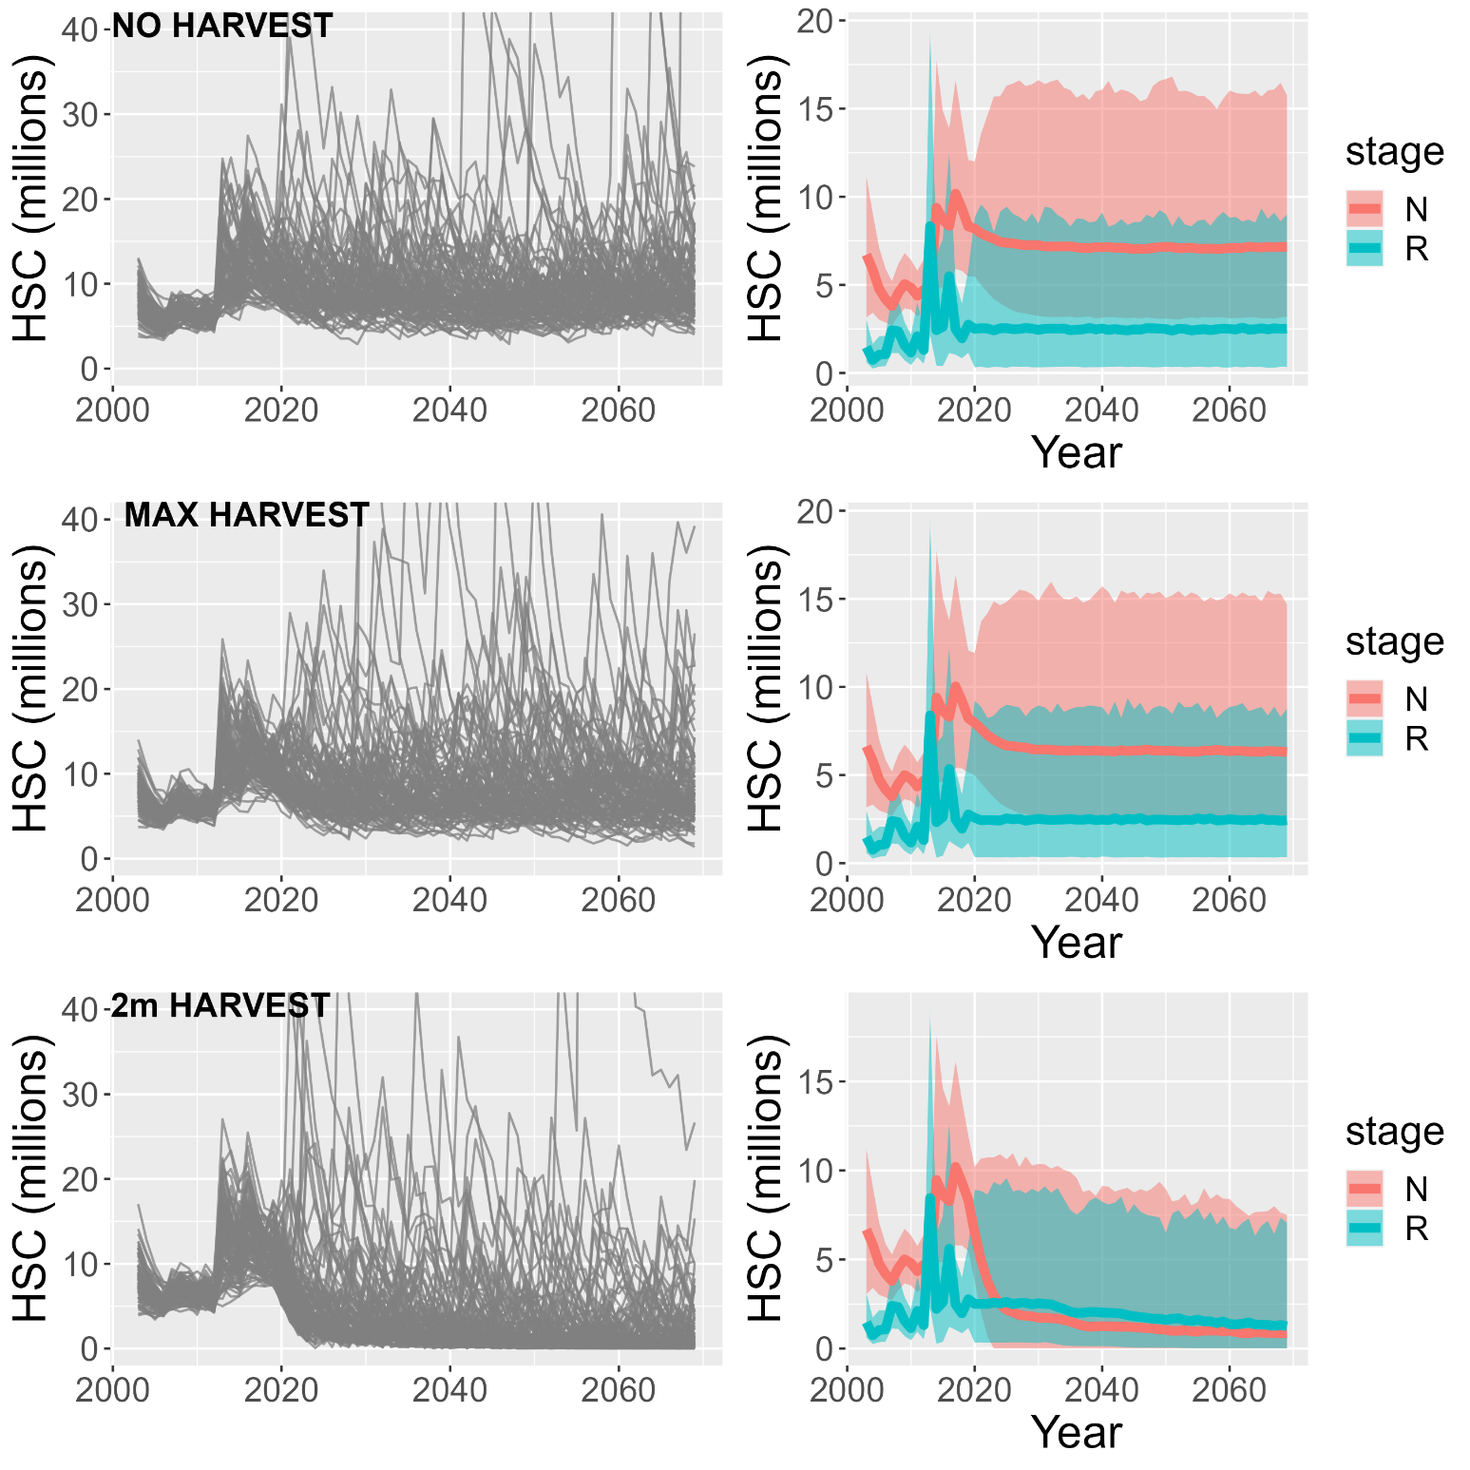
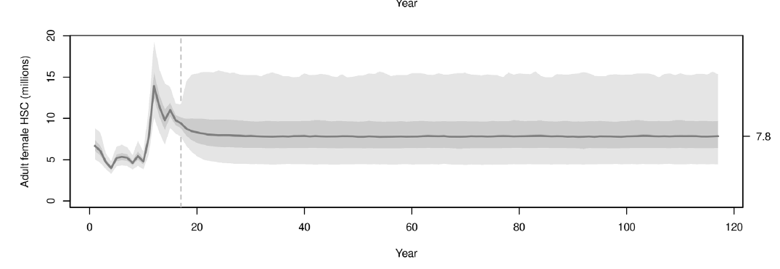

Slide 42
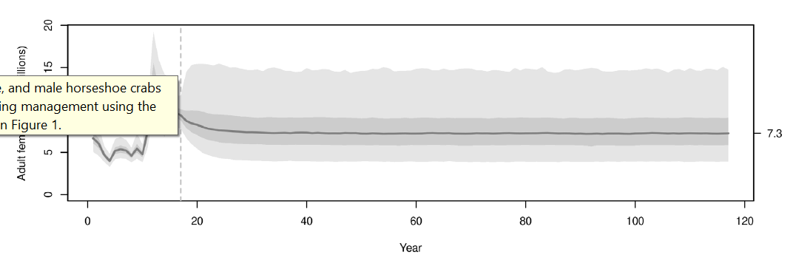

Slide 43
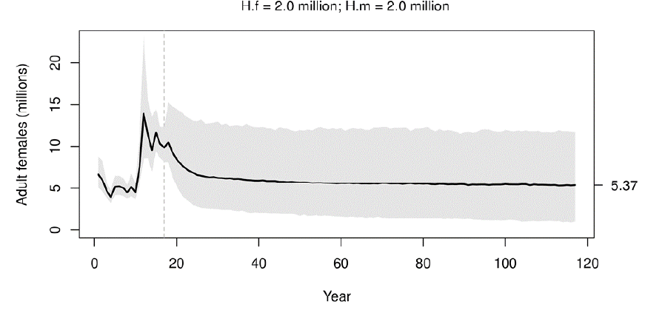

Slide 44
Fundamentals of population ecology (and statistics): error checking
Does the model fit the training data?
Goodness of fit tests
Comparison with alternative and null models
AIC, R-squared, RMSE
Does the model fit independent testing data?
Can it be used for effective forecasting?
How does it compare to null model benchmarks?
RMSE, bias

Slide 45
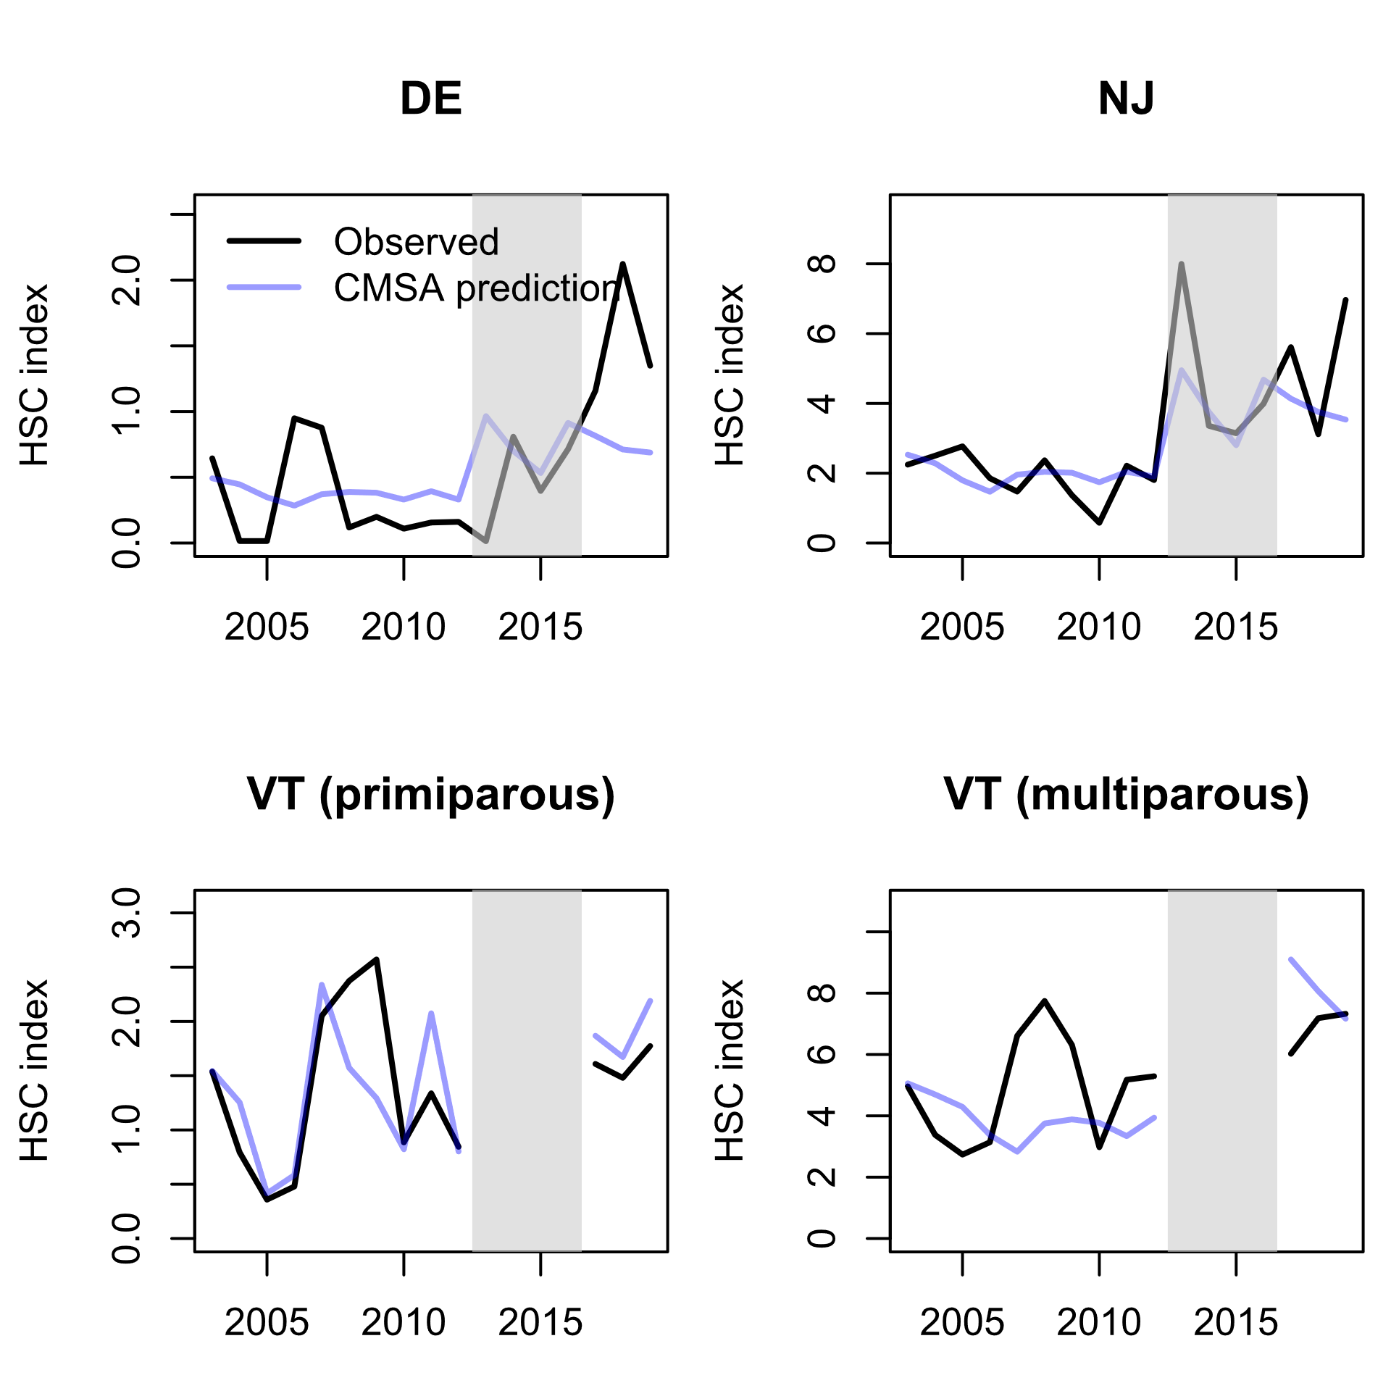

Slide 46
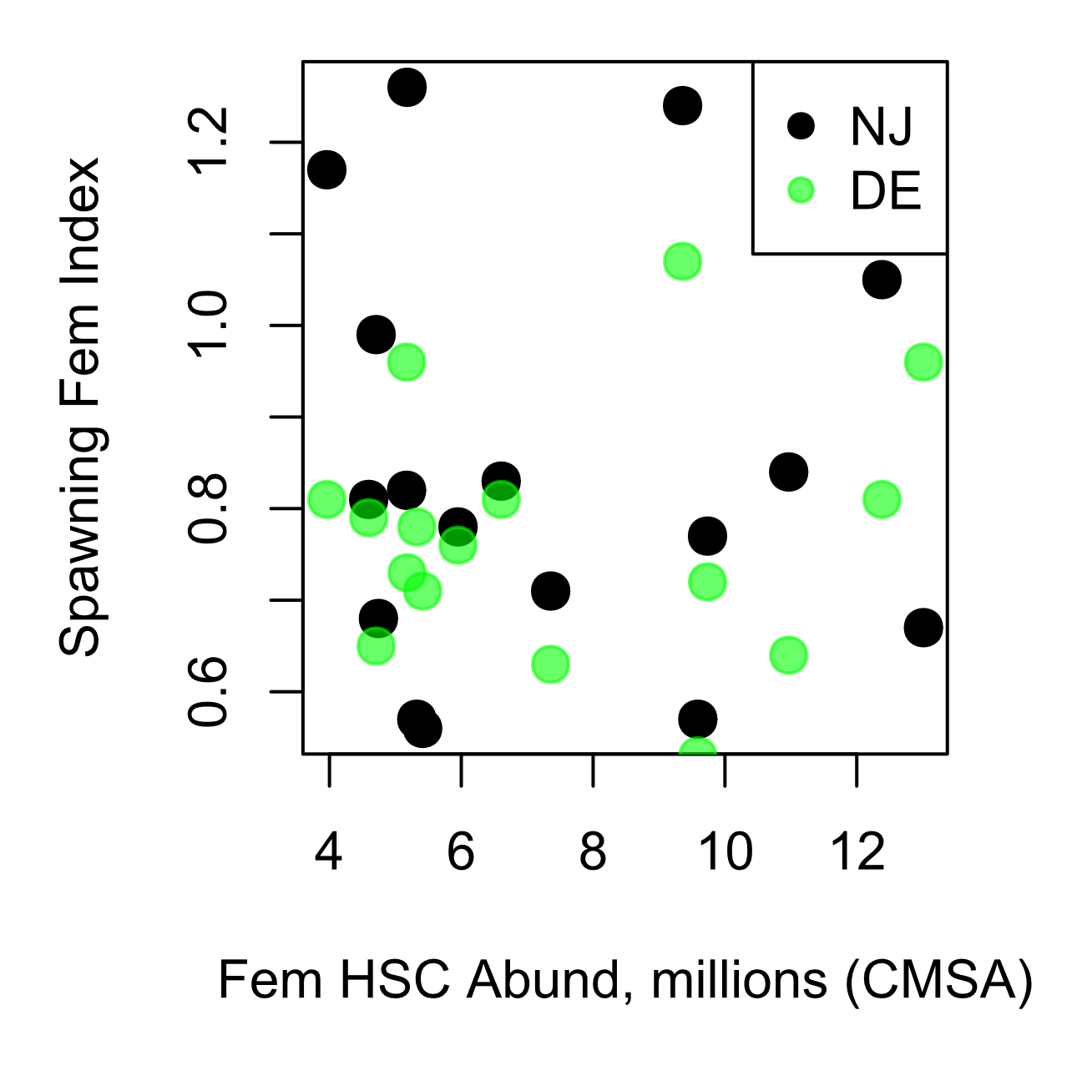

Slide 47
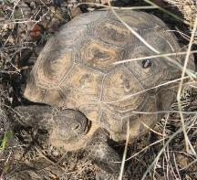
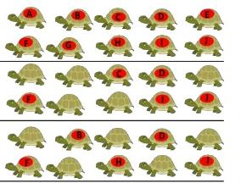
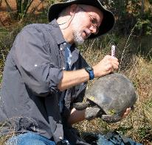
Fundamentals of population ecology: estimating demographic rates
Capture-mark-recapture and telemetry data
Mojave desert tortoise:
20+ sites, >9,000 individuals marked over several decades
 | Year
Animal | 1 | 2 | 3
A | 1 | 1 | 1
B | 0 | 0 | 1
C | 0 | 1 | 0
…
Year 1
Year 2
Gopher tortoise:
2+ sites,
>6,000 individuals marked over two decades
Year 3
Capture history data can contain information on both survival and recruitment as well as movement

Slide 48
Parameter estimation in the revised ARM
Red Knots (REKN)
Use mark-resight data to estimate survival.
Use aerial count data to estimate Lambda and recruitment
Both data sources included in same model for improved inference (IPM)
Horseshoe Crabs (HSC)
Use “swept area” trawls to estimate total N of females and males
Total abundance for each sex and for two age classes: new recruits and older adults
Surveys were not conducted for a consecutive 4-year period (2013 to 2016)
Use CMSA model to produce estimates of recruits and adults using multiple data sources
Relative abundance from DE and NJ trawls (no recruitment info), harvest info
Use CMSA results to fit a probability distribution for the generation of new recruits

Slide 49
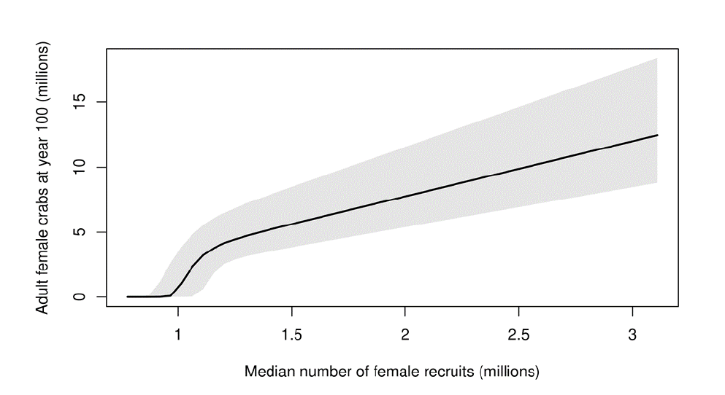
Post-gap years: 1.9 million
VT gap years: 4.21 million
Pre-gap years: 1.12 million
Avg., excluding gap
Avg., ARM report
Avg., ARM supp.
4
Notes:
Figure 33 original report

Slide 50
Modeling Overview: Revised ARM
Horseshoe Crab (HSC) abundance and population dynamics
Fitted to data using CMSA in AD Model Builder
Projection of future abundance using R
Red Knot (REKN) population dynamics model
Fitted to data using IPM in R/JAGS
Projection of future abundance using R
Management Optimization
Simulate HSC and REKN under alternative harvest regimes (‘functions’)
Identify the “maximum utility” harvest functions for HSC harvest and REKN conservation using ADP algorithm in R
Use the optimal harvest functions for annual harvest recommendations

Slide 51
Let’s discuss!

Slide 52
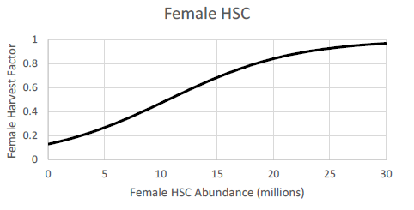
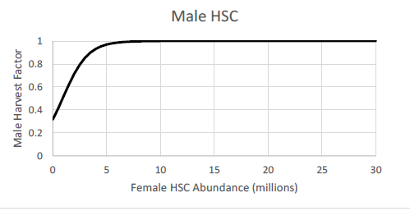
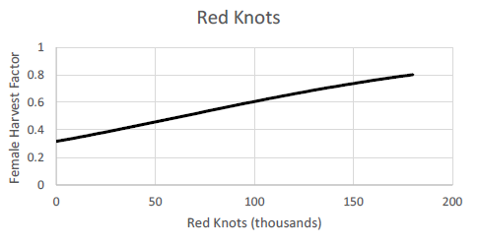
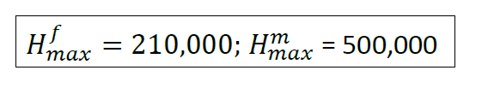
Harvest Policy Functions

Slide 53
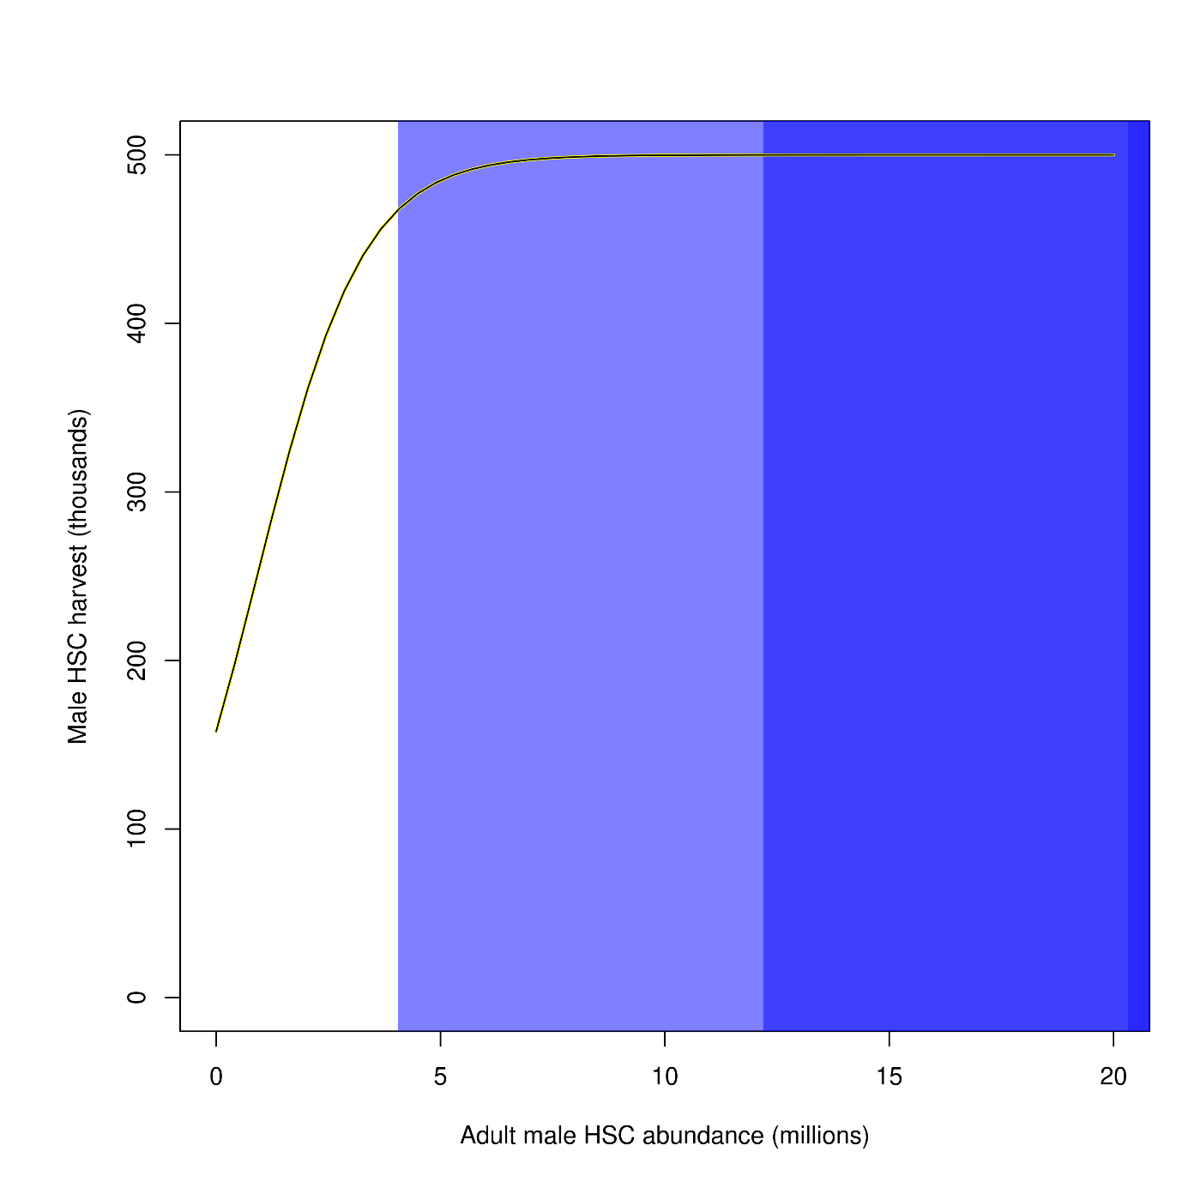
Results: Optimal Harvest Policy Functions

Slide 54
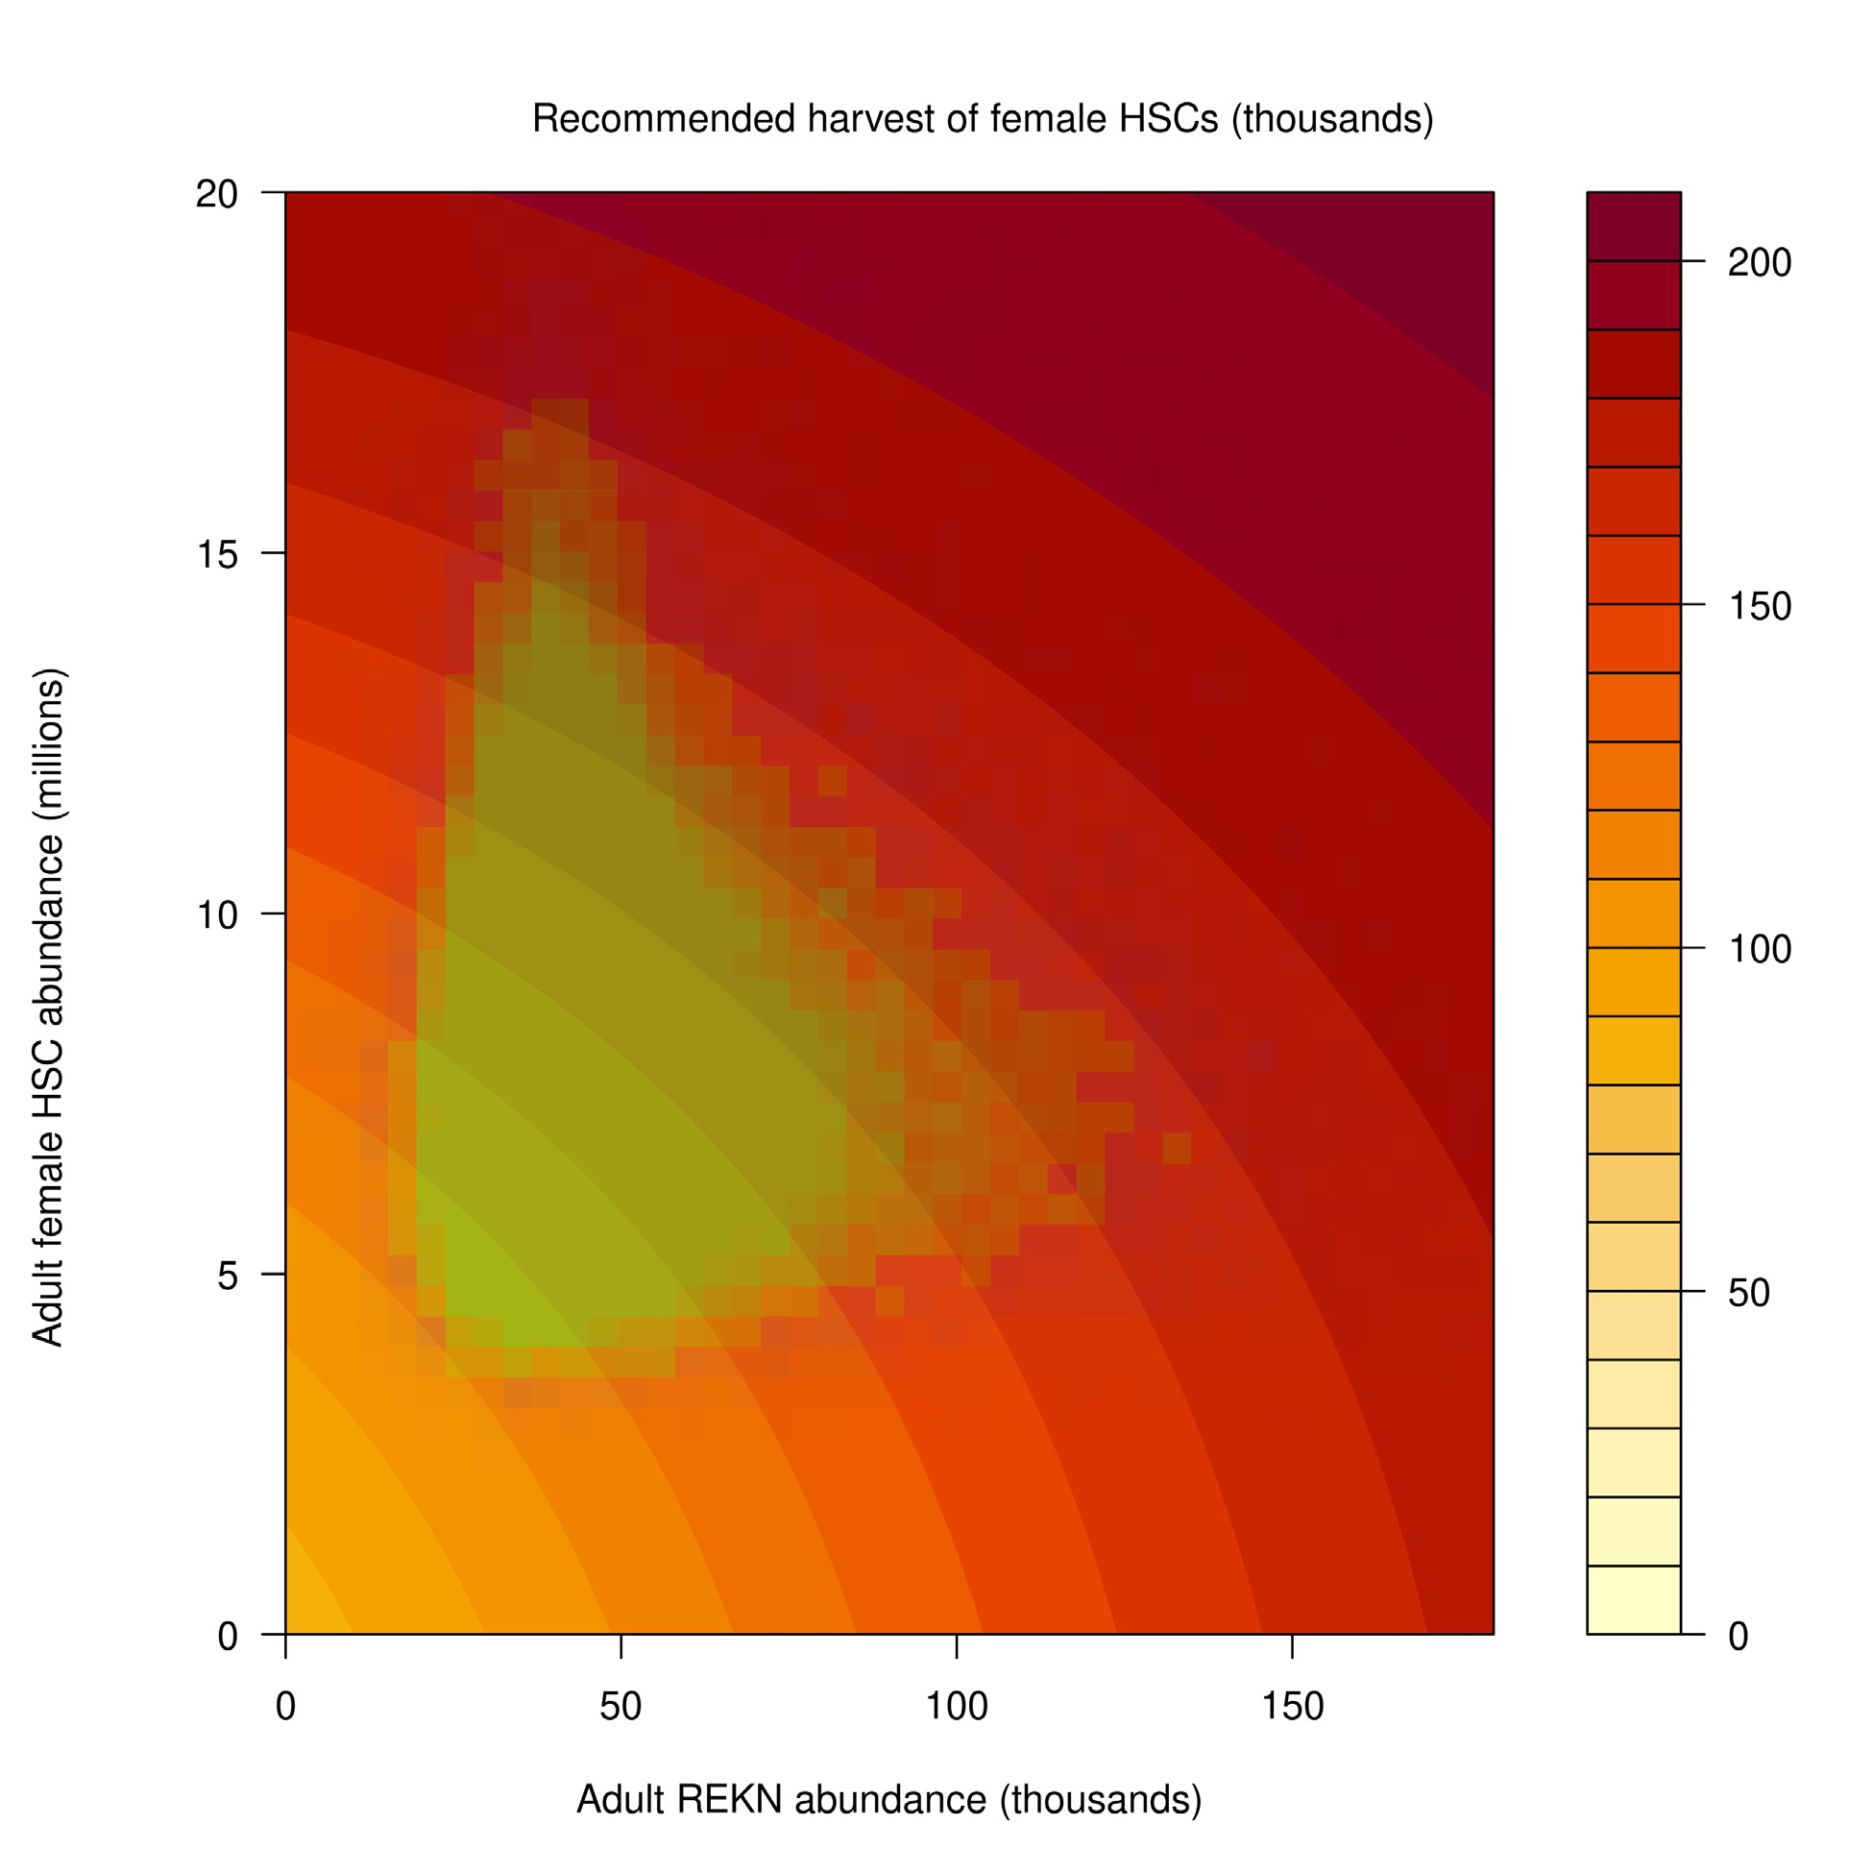
Results: Optimal Harvest Policy Functions

Slide 55
Modeling Overview: Revised ARM
Horseshoe Crab (HSC) abundance and population dynamics
Fitted to count data using CMSA in AD Model Builder
Projection of future abundance using R
Red Knot (REKN) population dynamics model
Fitted to mark-resight data and aerial count data using IPM in R/JAGS
Projection of future abundance using R
Management Optimization
Simulate HSC and REKN under alternative harvest regimes (‘functions’)
Identify the “maximum utility” harvest functions for HSC harvest and REKN conservation using ADP algorithm in R
Use the optimal harvest functions for annual harvest recommendations

Slide 56
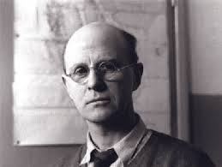
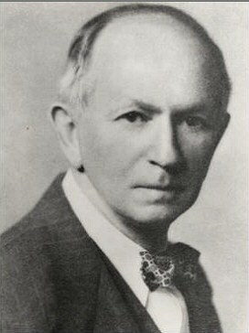
Aside: mathematics and population ecology
“Like most mathematicians, he takes the hopeful biologist to the edge of the pond, points out that a good swim will help his work, and then pushes him in and leaves him to drown.”
“The importance of the method is this: if we know certain variables, mostly desired by ecologists and in some cases already determined by them, we can predict certain results which would not normally be predictable or even expected by ecologists. The stage of verification of these mathematical predictions has hardly begun; but their importance cannot be under-estimated, and we look forward to seeing the further volumes of Lotka’s studies.”
- Charles Elton
Charles Elton
Alfred Lotka

Slide 57
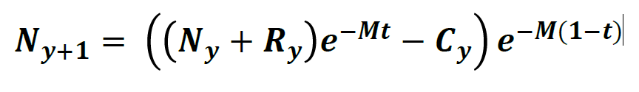
HSC Population Model: Catch Multiple Survey Analysis (CMSA)
Approved during the 2019 HSC stock assessment for use as the best estimate of HSC abundance in the DE Bay area
y = year
N = multiparous crabs
R = primiparous crabs
C = catch (bait + biomedical + dead discards)
M = natural mortality (0.30)
t = fraction of the year of harvest midpoint

Slide 58
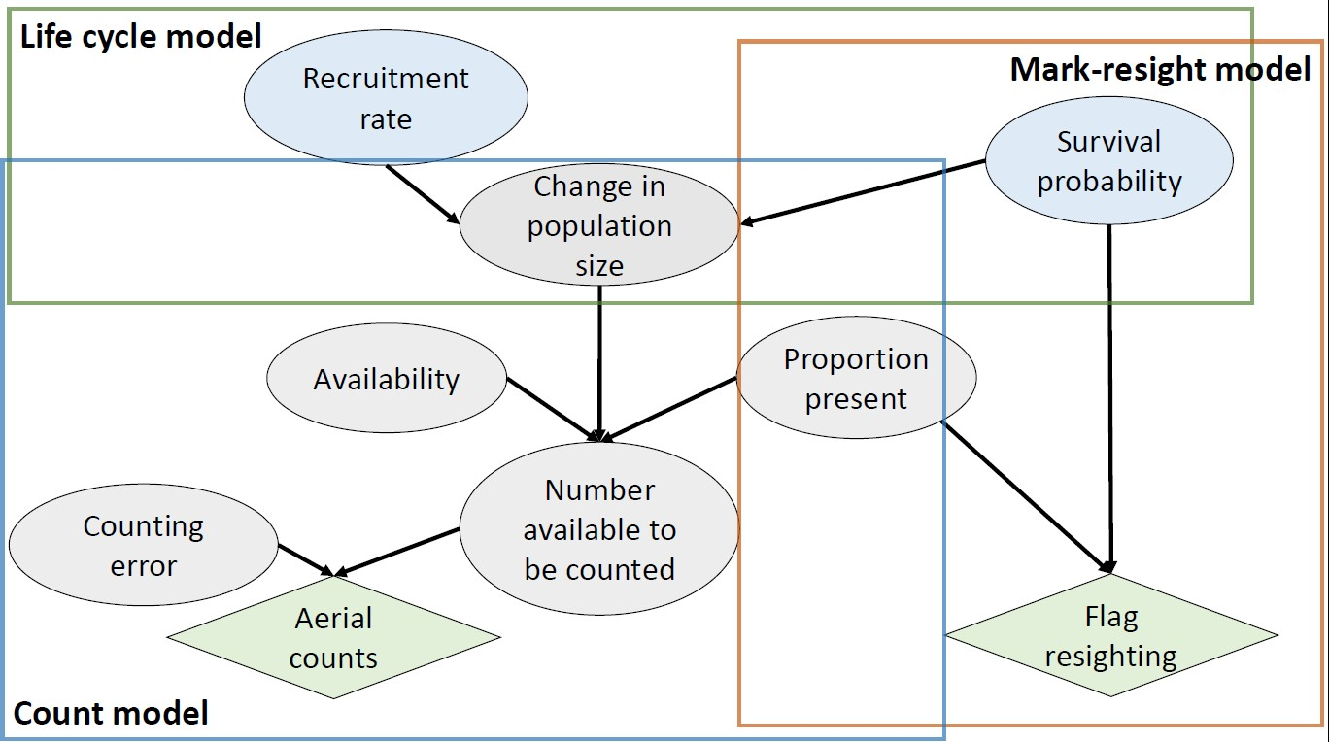
Red Knot Integrated Population Model (IPM)

Slide 59
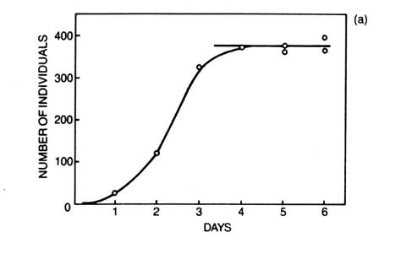
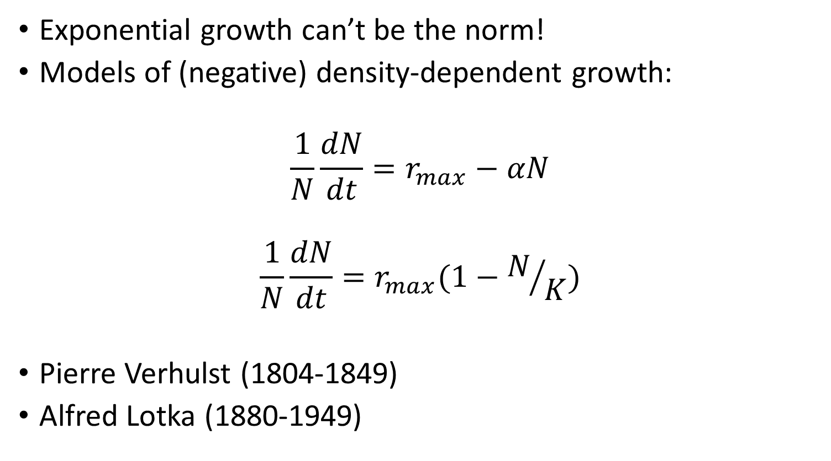
Fundamentals of Population Ecology: Population Regulation
Exponential growth can’t be the norm!
Models of (negative) density-dependent growth:
$$\frac{1}{N}\frac{dN}{dt}=r_{max}−αN$$
$$\frac{1}{N}\frac{dN}{dt}=r_{max}(1−N/K)$$
Pierre Verhulst (1804-1849)
Alfred Lotka (1880-1949)
Per capita population growth rate

Slide 60
Density dependence in the ARM model
Red Knot
Ceiling- recruitment fails above N=120k
Horseshoe Crab
Neither exponential growth nor density dependence
Recruitment is simply a constant regardless of what the population size is!
Mortality is constant – set at 30%
It’s based on data- but it violates basic population ecology
Recruitment is attenuated below 3.75m females

Slide 61
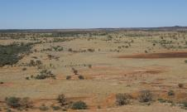
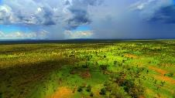
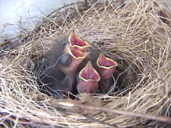

Stochasticity
Population processes are often inherently unstable and unpredictable
Environmental stochasticity
Fluctuations in vital rates caused by environmental variation
Food supply, predators, diseases, weather
Demographic stochasticity in small populations
Life events are unpredictable in the history of an individual
Survival, reproduction, offspring sex

Slide 62


Fundamentals of population ecology: Threats to populations
Deterministic threats
Harvest, road mortality
Habitat degradation and loss
Invasive species and disease
Toxins
Stochastic threats
Demographic and environmental stochasticity
Catastrophes
Loss of genetic diversity

Slide 63


Fundamentals of Population Ecology: Predator-Prey Dynamics
α=100; β=0.4; δ=0.12; γ=80

Slide 64
Prey-predator dynamics in the ARM
REKN populations depend on prey (HSC)
Prey-dependent numerical response: more prey means more food, and therefore higher survival
Survival is the same regardless of REKN abundance: 1 million REKN have same survival as 100 REKN at given abundance of HSC
Ratio dependent functional response makes more sense?
HSC population is not affected by predation
No two-way interaction

Slide 65

Modeling Predator-Prey Dynamics
“Functional responses” relate per-capita predation rate to prey population size
“Numerical responses” relate per-capita growth in the predator population to prey population size
Can the per-capita predation rate be a function of predator densities as well as prey? (ratio-dependent functional response…)

Slide 66

Generalized prey-predator growth equations
$$\left\{\begin{aligned}\frac{∂N}{∂t}=f\left(N\right)∙N−G(N,P)∙P \\ \frac{∂P}{∂t}=e∙G\left(N,P\right)∙P −u∙P\end{aligned}\right.$$

Slide 67
Habitat loss
Epidemic disease
Overhunting
Invasive species
Small, fragmented
isolated populations
Demographic
Stochasticity
Environmental
Variation
Loss of genetic
diversity
and Inbreeding
Reduced N
EXTINCTION
VORTEX
Catastrophes
Reduced adaptability, survival and reproduction

Slide 68
Red Knot (REKN) Population Model
Three components:
Mark-resight model – estimates survival probability and site use while accounting for imperfect detection using mark-resight data (2005-2018)
Count model – estimates ΔN among years based on aerial count data
Matrix population model – describes the underlying population dynamics that link survival and recruitment to ΔN

